Slide 1
ONNEFE
Online News Feeds
(Online News Feeds Management System)

Slide 2
Project Team (Dr. Naveen Tewari)
Soniya Bisht
Sonu Dhami
Suraj Sanwal
Shivam Sah
Shubodh Digari

Slide 3
Online News Feeds
Online News Feed(ONNEFE) is a software system where a user can view the news of their interest. Newsfeed is the constantly updating list of stories in the middle of you homepage Newsfeed include status updates, photos, videos, links, app activity and likes from People, pages and groups that you follow on Facebook. This news feed software basically Enables the user to focus upon the news and its updates tie to time. Many websites that are Regularly updated have an RSS feed, also known as a ‘news feed’. This allows you to see updated Content quickly and easily without having to navigate to the actual site. ‘RSS’ stands for ‘really Simple syndication’. The order of stories in your news feed is influenced by who posted the Story, the number of comments and likes it received, and what kind of story it is (ex: photo, Video, status update).

Slide 4
Data Flow Diagram (Context or 0-level)
News Feed Management System
Admin
Admin
Login
News
User
User

Slide 5
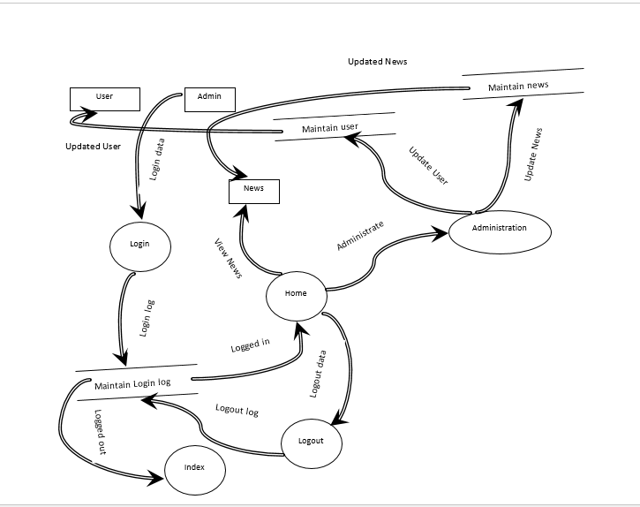
1-level DFD

